Slide 1
Building Web Services with Jarvis (Workshop SA2)
Brian Becker

Slide 2
A Few Administrative Items
The hotel has allotted one "snack" per attendee at the breaks. Please respect that.
Please fill out the Workshop Feedback form:
Preferably after the workshop
If you are not comfortable giving the filled out form to me, there will be someone outside the room after the workshop to collect them.
If you want me to fill out the form for you, I will ☺

Slide 3
Introductions and Agenda
A bit about me…
https://aplwiki.com/wiki/Brian_Becker
And you?
Three ~1-hour sections with two 15-minute breaks
Introduction to Web Services and Jarvis
Break
Jarvis Configuration and Web Service Design
Break
Sample "Phonebook" App

Slide 4
Objectives for this Workshop
Be able to define a simple web service
Understand most of the "important" Jarvis configuration settings
Understand what's available in Jarvis to build more complex services
Get your feedback
Not an objective: teach you in depth Jarvis or HTTP

Slide 5
Miscellaneous Stuff…
Ask questions!
But please be mindful of time and the specificity of the question.
Offer suggestions
Features you'd like to see or think Jarvis should have
Techniques – is there a better way to do something?
Internally, Jarvis uses(⎕IO ⎕ML)←1 and today's exercises will as well
Your application code can use whatever best suits you
We will be starting a lot of instances of Jarvis today. Best practice is to close the instance before opening another to avoid "port in use" conflicts.

Slide 6
Quick Survey
How many of you have:
Used a web service either directly or indirectly?
Written a web service?
Used Jarvis?
Understand HTTP – cookies, headers, methods, etc?

Slide 7
On Your Mark…
When you see [SA2] in text and examples, it refers to the folder where you installed the SA2 workshop materials.
SA2 materials downloaded?
Jarvis downloaded?
Local port available?

Slide 8
Get Set…
⍝ Start Dyalog APL
)clear
sum←{+/⍵}
rotate←⌽
]load [SA2]/Jarvis

Slide 9
Go!
⍝ you can specify a port other than 8080 if necessary
j←1⊃Jarvis.Run 8080 #
]open http://localhost:8080
]load HttpCommand
(HttpCommand.GetJSON 'post' 'localhost:8080/sum' (⍳5)).Data

Slide 10
What did we just do?
We defined and started a web service
Defined "endpoints" for the service
Started the service
Used a browser to open a page that contained a JavaScript client to communicate with the service
Used HttpCommand as a client

Slide 11
Web Service or Web Server
Web Service
Uses HTTP
Machine-to-machine
Variety of clients
Python, C#, APL, JavaScript
Specific API
Web Server
Uses HTTP
Human interface
Client is typically a browser using HTML/CSS/JavaScript
Notes:
API – Application Programming Interface

Slide 12
Introducing Jarvis
JSON and REST Service
Supports two "paradigms" - JSON and REST
A service can run only one paradigm
Jarvis' ancestry
Originally written as JSONServer in December 2017 for a client over a weekend
Core HTTP server has been in use for many years
REST capability was added at a client's request and renamed Jarvis
Notes:
Mention that we'll briefly talk about REST, but the focus will be on JSON today

Slide 13
Jarvis Design Philosophy
Assume as little as possible about how the user will use it
Be flexible - gives the user the flexibility to use Jarvis as he deems best, not how I dictate.
CodeLocation can be a ref, a name of a ref, or a folder specification
Configuration parameters can be specified in a configuration file, a namespace passed to the constructor, or set individually.
Provide sensible default behavior to hide some of the nuances of HTTP and web services, but also provide low-level access for the users who need it.
Use "hooks" for the user to inject code into the flow at obvious points.
Startup, at the start of each request, session initialization, authentication, …
If you feel the need to modify the Jarvis code itself – we probably need to add another hook.
Need-driven design – if you need it, we'll try to put it in
CORS support and the REST paradigm are two examples

Slide 14
REST
The HTTP method, URI, and payload specify what to do.
Standard HTTP methods for operations
GET – retrieve a resource POST – create a resource PUT – replace a resource PATCH – update a resource DELETE – delete a resource
URI Endpoints are "resources"
Payloads are often JSON or XML
The GitHub REST API is a good example https://docs.github.com/en/rest/repos/repos
GitHub API (abbreviated) Examples
Get the commits for a repository GET /repos/Dyalog/Jarvis/commits
Create an organization repository POST /orgs/Dyalog/repos {"name":"NewRepo"}
Update a repository PATCH /repos/Dyalog/Jarvis {"name":"NewName"}
Notes:
Mention that there is a list of criteria to determine the "RESTfulness" of a web service.

Slide 15
GitHub Web Service REST Example
]load HttpCommand #.HttpCommand
⊢ r ← HttpCommand.Get 'https://api.github.com/orgs/dyalog-training/repos' [rc: 0 | msg: | HTTP Status: 200 "OK" | ⍴Data: 43023]
100↑r.Data [{"id":537497880,"node_id":"R_kgDOIAmRGA","name":"2022-SA1","full_name":"dyalog-training/2022-SA1","
⊢ r ← HttpCommand.GetJSON 'get' 'https://api.github.com/orgs/dyalog-training/repos' [rc: 0 | msg: | HTTP Status: 200 "OK" | ⍴Data: 8]
r.Data.name 2022-SA1 2022-SA2 2022-TP2 2022-SA3 2022-SP1 2022-SP2 2022-TP3 .github
↑r.Data.(name updated_at) 2022-SA1 2022-10-05T08:28:28Z 2022-SA2 2022-10-05T21:24:30Z 2022-TP2 2022-09-21T11:29:37Z 2022-SA3 2022-09-24T06:56:29Z 2022-SP1 2022-09-28T13:04:05Z 2022-SP2 2022-10-06T14:00:03Z 2022-TP3 2022-09-29T18:23:40Z .github 2022-10-06T13:35:40Z

Slide 16
REST Paradigm
Write a function for each HTTP method that your service will support
response ← GET request request is the request object response is the response payload
The function will parse the path and endpoint to identify the resource
GET /customers ⍝ get all customers GET /customers/10 ⍝ get customer 10 information GET /customers/10/invoices ⍝ get customer 10's invoices
There are other principles that help determine a service's "RESTfulness" including:
Statelessness
Caching of responses
Jarvis does not address these

Slide 17
JSON Paradigm
Endpoints are result-returning monadic or dyadic APL functions
Right argument is the request payload
Optional left argument is the request object itself
All requests use HTTP POST method
Request and response payloads are JSON
Jarvis handles all conversion between JSON and APL formats

Slide 18
REST or JSON?
REST
Good for "database" applications CRUD – create, read, update, delete
API requires thought/discipline For instance, how to implement a query? get /customers/country/Denmark get /customers?country=Denmark
Need to understand HTTP requests
HTTP Method, Path, Query Parameters, Headers, Payload, Status Codes
JSON
Good for functional endpoints
API is more flexible
API is easier to implement
Probably suits the "APL mindset" better
Understanding HTTP requests is useful but generally necessary

Slide 19
JSON Paradigm
To send a request to a Jarvis service running the JSON paradigm, the client performs the following:
Specify the host and endpoint
http://localhost:8080/sum
Specify the payload/data/body in JSON format
[2,4,6]
Specify the content-type as 'application/json'
Specify the HTTP method as POST

Slide 20
Anatomy of a JSON HTTP Request
HTTP Method
Endpoint
Host Address
POST /sum HTTP/1.1 Host: localhost:8080 User-Agent: Dyalog-HttpCommand/5.1.3 Accept: */* Content-Type: application/json Content-Length: 7 [2,4,6]
Headers
Payload

Slide 21
Client Examples
JavaScript | var xhr = new XMLHttpRequest(); xhr.open("POST", http://localhost:8080/sum); xhr.setRequestHeader("content-type", "application/json"); xhr.send("[1,2,3,4]"); xhr.response;
PowerShell | $url = http://localhost:8080/sum $hdrs = @{'content-type' = 'application/json'} $body = '[1,3,5,7,9,11]' Invoke-WebRequest –Method Post –URI $url –Headers $hdrs –Body $body
Python | import requests import json url = 'http://localhost:22333/sum' hdrs = {"content-type":"application/json"} array = [2,4,6,8] resp = requests.post(url, data=json.dumps(array), headers=hdrs) print(resp.json())
curl | curl -d "[1,2,3,4,5]" -H "content-type:application/json" http://localhost:8080/sum
APL | HttpCommand.GetJSON 'post' 'localhost:8080/sum' (⍳5)

Slide 22
Some Web Service Design Questions
Stateful or Stateless?
Does your service need to maintain "state" between requests?
If so, where to maintain that state? On the client or in the server?
Security?
HTTPS
Authentication/Authorization
Scalability?
Come to the Deploying Services workshop ☺

Slide 23
JSON Briefly
Lightweight, language-neutral, data-interchange format
https://www.json.org/json-en.html
Scroll down to Languages section

Slide 24
JSON and APL
JSON is a natural and complementary fit with APL
⎕JSON converts between JSON and APL representations
APL arrays with rank >1 can be split to make vectors of vectors (of vectors…)
 | JSON | APL
Number | 42 | 42
String | "hello" | 'hello'
Array | [ 2, "hello" ] [[1,2,3],["hi","there"]] | 2 'hello' (1 2 3)('hi' 'there')
Object | {"number": 2, "greeting":"hello"} | obj←⎕NS '' obj.(number greeting)←2 'hello'

Slide 25
Jarvis Configuration Settings
Can be specified
in a JarvisConfig JSON file
in environment variables (must use Jarvis workspace) or in the constructor argument to the Jarvis class
directly in the Jarvis instance
Settings take precedence in the order above
We'll refer to the collection of settings as "JarvisConfig"

Slide 26
Running Jarvis
Jarvis.dws
At least one Jarvis config setting must be set as an environment variable
Jarvis.dyalog
Create an instance
Set configuration
And go!
dyalog/Jarvis Docker container
a public container found on DockerHub https://hub.docker.com/dyalog/jarvis

Slide 27
Useful Functions
j←⊃Jarvis.Run args – create and start a Jarvis server
j←Jarvis.New args – create a Jarvis server
j.Start – start the Jarvis server
j.Stop – stop the Jarvis server
j.Config – show the Jarvis server's configuration

Slide 28
Jarvis.Run and Jarvis.New
r←Jarvis.Run args – creates and starts a Jarvis server
args is one of:
a character vector containing either the name of a JarvisConfig file or CodeLocation
a reference to a JarvisConfig namespace
[1] the port Jarvis is to list on [2] CodeLocation [3] (optional) the paradigm to use ('JSON' or 'REST'). Default is 'JSON' [4] (optional) the name of a JarvisConfig file or reference to a JarvisConfig namespace
r is [1] a reference to the Jarvis instance [2] a return code (0 means "OK" and Jarvis was started, non-zero means error) [3] a (hopefully useful) message if the return code is non-zero
If you forget to capture the result of Jarvis.Run, you can use j←⊃⊃⎕INSTANCES Jarvis
Jarvis.New takes the same arguments as Jarvis.Run but just returns a reference to the instance

Slide 29
CodeLocation
is where Jarvis looks for your code
Namespace reference or name: #.myAPI or '#.myAPI' Jarvis.Run 8080 #
Folder name: either fully qualified or relative to:
Workspace if not CLEAR WS
Folder of JarvisConfig file if it exists
Jarvis' source folder (assuming you loaded Jarvis from file)

Slide 30
HTML Interface
Jarvis is not a web server but it can serve static HTML content and has a built-in, simple, HTML interface.
This interface was developed for demonstration and testing purposes.
It is useful for for showing what endpoints are exposed.
The HTMLInterface configuration setting controls the HTMLInterface:
0 means disable any HTML interface
1 (the default) means enable the built-in HTML interface
The name of a folder or file containing the content for an HTML interface This is how TryAPL.org works.

Slide 31
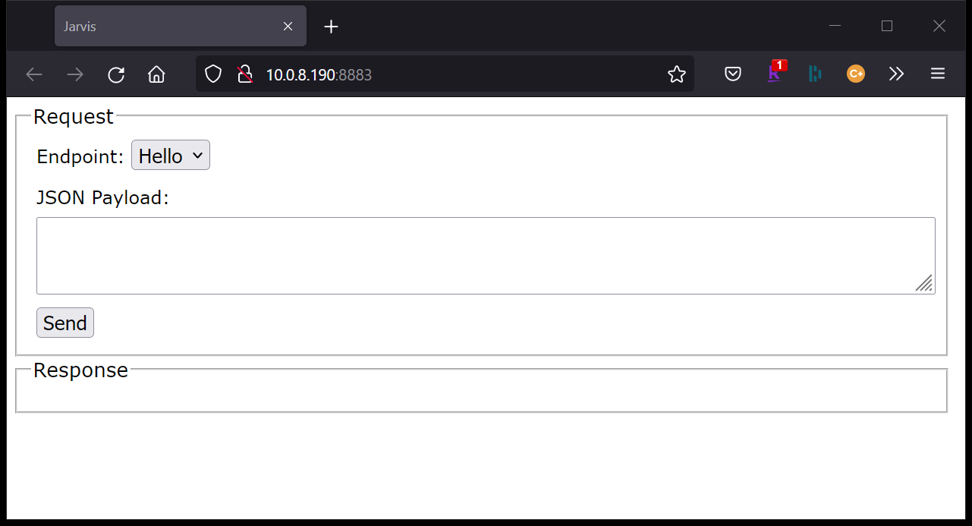
HTML Interface

Slide 32
Exposing and Hiding Endpoints
By default, all functions in CodeLocation (and below) are exposed as endpoints.
j←Jarvis.Run 8081 '[SA1]/SampleCodeLocation' ]open https://localhost:8081
Use IncludeFns and ExcludeFns which are vector(s) of:
Function names: 'sum' 'rotate'
Strings with wildcards: 'hidden.*'
regex: "^[A-Z].*"
Any combination of the above
IncludeFns is run before ExcludeFns

Slide 33
Tying some of the pieces together…
settings←⎕NS '' settings.Port←8882 settings.CodeLocation←'[SA2]/SampleCodeLocation' settings.ExcludeFns←'hidden.*' 'utils.HideMe'
j←Jarvis.New settings j.Start j.Stop
)ed file://[SA2]/SampleCodeLocation/JarvisConfig.json j←Jarvis.New '[SA2]/SampleCodeLocation/JarvisConfig.json' j.Start j.Stop

Slide 34
Ready for the next level?
Up to now we've used simple monadic functions as our endpoints.
If you have a dyadic (or ambivalent) function, a reference to the HTTP Request object is passed as the left argument.
This provides access to metadata for the request that can be used to further validate the request.
It also makes it easier for us to "be a good citizen" and conform to some common practices for web services.

Slide 35
Request Object
An instance is created for each HTTP request received by Jarvis.
The two main uses for the request are:
querying request parameters sent by the client
headers, cookies, peer certificate, among others
managing response content to be send back by Jarvis
HTTP status code and message, and the payload
Simple web services may never need to use Request

Slide 36
Useful Request Functions
{status}←{message} Fail HTTPStatus {status}←{message} SetStatus HTTPStatus Sets the HTTP response status code and status message If message is not supplied, use the standard message (if there is one) for the code
value←GetCookie name Return the value of the cookie named name or '' if no cookie with that name exists.
value←GetHeader name Return the value of the HTTP header named name or '' if no header with that name exists.
name SetCookie cookie Set a response cookie. cookie is the cookie value with optional additional cookie settings appended and separated by ';'
name SetHeader header Set a response header

Slide 37
Some Request Object Fields
Response – reference to a namespace containing Status, StatusText, and Payload
Server – reference to the Jarvis server instance
Session – reference to the session namespace, if using sessions
EndPoint – the endpoint for the request
Password – if using HTTP Basic authentication, the supplied password
UserID – if using HTTP Basic authentication, the supplied user ID.

Slide 38
HTTP Response Statuses
HTTP statuses reflect the success or failure of the server to satisfy the request
Jarvis will set appropriate HTTP status codes for conditions it detects.
Success
Endpoint not found
Unauthorized request
You can use req.SetStatus inside your endpoints to set appropriate statuses.
2xx – success
200 - Success 201 - Created 204 - No content
4xx – Client Error
400 - Bad Request 401 - Unauthorized 403 - Forbidden 404 - Not found 405 - Method not allowed
5xx – Server Error
500 - Internal server error

Slide 39
Hooks
Jarvis has several "hooks" where you can inject your code. You set a hook by assigning the name of your function that implements the hook to one of the following:
AppInitFn – called when Jarvis starts AppCloseFn – called when Jarvis stops SessionInitFn – called when a new session is created (sessioning must be enabled) AuthenticateFn – called on every request ValidateRequestFn – called when the request is received but before Jarvis starts processing the request
All of the hooks take a Request object as their right argument and return 0 if there is no error.
If you do not specify a hook, Jarvis uses {0} as its definition.

Slide 40
Debugging
We know that our application code won't fail.
And we're confident that Jarvis itself is without flaw.
And users always send us the data we're expecting.
But just in case that smallest of possibilities happens and things don't behave as we expect…
Here are some tips to help you debug a Jarvis web service…

Slide 41
Debugging
Jarvis.Debug←0 No debugging, Jarvis traps all errors and reports them as 500
Jarvis.Debug←1 Jarvis suspends on any error
Jarvis.Debug←2 Jarvis suspends just prior to calling user endpoints or hooks
Jarvis.Debug←4 Jarvis suspends just after receiving the client request
Values are additive: 5 = 1+4

Slide 42
Debugging
When you have a reproducible error, but don't try to reproduce it from a client running in the same APL process as Jarvis. In other words, don't use HttpCommand to produce the error from the same session that Jarvis is running in.
Then, in the Jarvis process, set Jarvis.Debug←1.
Switch to the client process and issue the request that causes the error.
Switch back to the Jarvis process (it should be suspended) and do your normal debugging.
Set Jarvis.Debug←0 and try to reproduce the error from the client
To debug your endpoint or hook code, Jarvis.Debug←2 and use the debugger to step through your code.

Slide 43
Other Debugging Aids/Hints
Check the configuration using j.Config
Use the built-in HTML interface to query and test endpoints. j.HTMLInterface←1
If you need to change Jarvis settings, it's safest to stop the server, make the changes, and start the server again.

Slide 44
Maintaining State between Requests
Client side
All necessary state is "bundled" by the client in the request, updated and bundled in the response by the server endpoint.
This is how TryAPL.org works.
Good for distributed/load balanced applications – it doesn't matter which server instance handles the request

Slide 45
Maintaining State between Requests
Server side
When a session starts, Jarvis creates
a session namespace
a session ID that is either sent as a cookie or a header
the cookie or header must be sent with every subsequent request to maintain session continuity. Cookies are preferred as they are sent automatically by many clients.
In a distributed/load balanced applications – you may need to make the request "sticky" so subsequent requests are handled by the same server

Slide 46
Session Configuration Settings
SessionIdHeader←'Jarvis-SessionID' ⍝ Name of the header field or cookie for the session token
SessionUseCookie←0 ⍝ 0 - use the header; 1 - use an HTTP cookie
SessionPollingTime←1 ⍝ how frequently (in minutes) we should poll for timed out sessions
SessionTimeout←0 ⍝ 0 = do not use sessions, ¯1 = no timeout , 0< session timeout time (in minutes)
SessionCleanupTime←60 ⍝ how frequently (in minutes) do we clean up timed out session info from _sessionsInfo

Slide 47
Session Example
In [SA2]/SessionDemo:
jarvisconfig.json: { "SessionInitFn" : "InitializeSession", "SessionTimeout" : .25, "Port" : 8889, "SessionUseCookie" : 1 }
∇ InitializeSession req [1] ⍝ initializes the session [2] req.Session.Sum←0 ∇
∇ r←req Add arg [1] ⍝ arg is an integer array [2] req.Session.Sum+←+/arg [3] r←req.Session.Sum ∇
j←Jarvis.Run '[SA2]/SessionDemo/jarvisconfig.json'

Slide 48
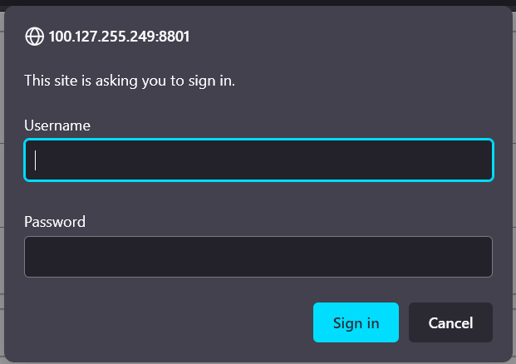
Authentication/Authorization
Jarvis supports HTTP Basic authentication
When used through a browser, the familiar credentials dialog will appear.
Credentials can also be provided in the URL or in an Authorization header.
NOTE: HTTP Basic authentication encodes but does not encrypt the user credentials. It should never be used over a unencrypted link.
You can also "roll your own" by creating a login endpoint and having the user enter their credentials.
There are usage patterns that you can employ to securely send credentials over an unencrypted link, but it's much simpler to use HTTPS.

Slide 49
Cross-Origin Resource Sharing (CORS)
Jarvis CORS support. Why might this matter to you?
If someone wants to call your web service from within a web page they've developed, CORS enables browsers to accept responses from your web service.
CORS is a deeper subject than we have time for in this workshop, but Jarvis' CORS support will be fully documented in the forthcoming documentation.

Slide 50
Exercise Time
Write a web service with 2 endpoints
One endpoint can be simple (monadic)
The request payload can be as simple or complicated as you like
The other endpoint should be dyadic
The request payload can be as simple or complicated as you like
In addition to the response payload that's calculated from the request payload, include something about the request itself in the response
If you're really brave, try adding hooks

Slide 51
Sample Phonebook Application
Users table
contains user credentials (login and password) for "admins"
admins can edit Users table and Phonebook table
Phonebook table
contains first name, last name, extension, and password
"owner" of an extension can edit their extension

Slide 52
Sample Phonebook Application
Users endpoints
AddUser
DeleteUser
UpdateUser
GetUsers
GetUserByLogin
Phonebook endpoints
AddPhonebookEntry
DeletePhonebookEntry
UpdatePhonebookEntry
GetPhonebookByExtension
SearchPhonebook

Slide 53
Sample Phonebook Application
All endpoints take a namespace argument
{"lastName":"Kromberg", "firstName":"Morten", …}
All endpoints return a namespace containing
rc – return code, 0 means "no error"
msg – informational message
payload – any data returned by the endpoint

Slide 54
Sample Phonebook Application
Three versions of the same application:
v1 – implements all the basic functionality for every endpoint but does not validate the request payloads nor implement any authentication/authorization.
v2 – implements authentication/authorization
v3 – implements request payload checking

Slide 55
What lies ahead…
New functionality will be driven by user needs
Release process will be more formal
Semantic versioning
GitHub Releases
Available as a Tatin package
Documentation is being written https://dyalog.github.io/Jarvis/
Training materials, more samples, webcasts are planned.

